Slide 1
Thinking unwise: a relational u-turn
Nick Barrow (Ma Student - Philosophy of AI, The University of York)
nab539@york.ac.uk | nickbarrow11@gmail.com

Slide 2
Structure - 4 Objectives
1
2
Introduce the robot rights debate
Establish Relationism as a case-by-case approach
3
4
Outline the Anthropocentrism debate
Critique the relationist
Relationist Anthropocentrism
Relational Relationism

Slide 3
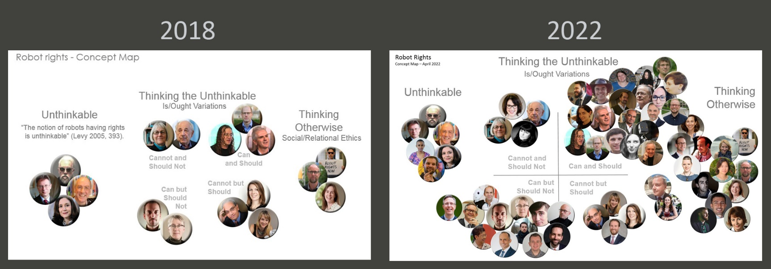
Robot rights?
—> Artificial Moral Status
Figure 1: “Here's one way to visualize the exponential growth in #robotrights research over the past 4 years. The original concept map from 2018 and the current state of the debate.” (Gunkel, 2022)

Slide 4
Property-based | ‘Thinking otherwise’ “…what’s going on ‘on the inside’ does not matter from an ethical perspective” (Danaher, 2020, p. 2025).
Autonomy (Floridi and Sanders, 2004) Psychological and Social Properties (Schwitzgebel and Graza, 2015) Sentience (Véliz, 2021; Eskens, 2017) Consciousness (Andreotta, 2021; Mosakas, 2020). | Behaviourism (Danaher) “…robots can have significant moral status if they are roughly performatively equivalent to other entities that are commonly agreed to have significant moral status” (Danaher, 2020, p. 2023). | (Western) Relationism (Coeckelbergh, Gunkel, Gellers) “…the question of social and moral status does not necessarily depend on what the other is in its essence but on how she/he/it...supervenes before us and how we decide, in “the face of the other” ...to respond” (Gunkel, 2018 pg. 96).

Slide 5
Relationism: a case-by-case approach
Rejects the ontological pursuit of property-based approaches
Instead, focuses on the extrinsic nature of our social relationships
Fundamentally committed to a case-by-case approach
For example, pets.

Slide 6
Motivation to ‘think otherwise’
In opposition to typical, property-based approaches:
Disagreement over which properties
Disagreement over the definitions of these properties
Epistemological issues arising from the detectability of properties
The use of anthropocentric properties

Slide 7
Against Anthropocentrism
Concerning personhood: humans, who are already considered persons,
“not only get to formulate the membership criteria of personhood but also nominate themselves as the deciding factor” (Gunkel, 2012 p. 66).
Based on human capacities, anthropocentric definitions nominate humans “both judge and jury” on who qualifies (Ibid p. 67).

Slide 8
Anthropocentric, property-based approaches
Identify beings already understood to have moral status and which of their properties are necessary
i.e., sentience, consciousness
This original being is always human
Consequently, such approaches utilise properties as proxies for human exceptionalism (Gunkel, 2012)

Slide 9
For Anthropocentrism
Anthropocentrism is often linked to Speciesism
But “this is exactly the point: robots are not humans” (Birhane and Dijk, 2020 p. 209)
Joanna Bryson: if we only instrumentalise robots, we cannot demean them
“Robots should be slaves…servants you own” (2010, p. 110)

Slide 10

Gunkel on viewing robots instrumentally
“…impose[s] unrealistic…impractical restrains on behaviour” and “strain against lived experience…social norms and conventions” (Gunkel, 2018 §4.2.1)
Eventually, an AI will breach human conventions of morality
It contradicts real-world human-robot interaction
Figure 2: A bomb disposal unit (Garber, 2013).

Slide 11
Anthropomorphism = moral consideration?
Birhane and Dijk (2020) “see no reason at all” (p. 110) for anthropomorphism to imply moral consideration
Fundamentally, we’d only treat them well “as they were the product of hard labour, expressions of human creativity”
This goes against the Relationist’s fundamental tenet
Gunkel can remain anti-anthropocentric

Slide 12
Anthropocentric Relationism
However, given the case-by-case nature of Relationism, moral consideration is necessarily assessed from a human perspective
Thus, it seems the Relationist also (and more literally) plays “judge and jury” on all claims of artificial moral status
How a robot is treated is determined by how a human evaluates their relationship with it

Slide 13
Gunkel’s response
Recently responded to a similar articulation of this argument provided by Henrik Sætra
“relationalism is arguably deeply anthropocentric because moral standing is derived exclusively from how human beings perceive and form relations with other entities.” (2021 p.6)
Gunkel: not a critique but actually an accurate characterisation as humans are rightfully at the centre of morality
Although Sætra’s critique is similar in spirit, it differs from mine as I have used Gunkel’s own words against anthropocentrism
In his own words, Gunkel critiqued the ability of humans to play “judge and jury”, having the power to dictate who joins their club
How can Relationism be consistent with this?

Slide 14
Relationism’s (lack-of) action guidance
I will first show that:
Relationism does not secure a true account of moral status
And, because of this
It collapses into extreme meta-ethical relativism

Slide 15
Relationism and moral status
‘True’ accounts of moral status apply to every agent
Relationism only accounts for “particular agents’ reasons vis-á-vis the individual at issue” (Jaworska and Tannenbaum, 2018 §5.5)

Slide 16
Relational Relativism
Cannot secure objective standards
“no moral judgements or standards (about any moral questions) are objectively true (or, correct) or false (or, incorrect)” (Moser and Carson, 2001 p. 3)
Case-by-case, individual evaluations – which is right?

Slide 17
Gunkel’s Ethical Pluralism
Relativism need not be construed negatively i.e., physics
Middle ground between relativism and absolutism – pluralism
Gunkel needs to explain how there can be a middle ground
Still have a practical issue – which values should we prioritise?
Day to day
Legal/Societal

Slide 18


Summing up
@thatssonick
nab539@york.ac.uk nickbarrow11@gmail.com
Introduced the robot rights debate
Established Relationism as a case-by-case approach
Outlined the anthropocentrism debate
Presented two criticisms against the Relationist:
That Relationism is, itself, Anthropocentric
That Relationism cannot sufficiently guide action

